Slide 1


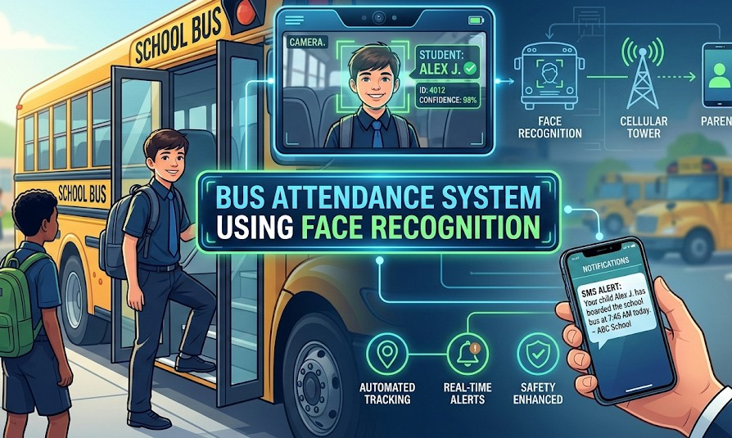



BUS ATTENDANCE
SYSTEM USING FACE RECOGNITION WITH SMS ALERTS

Slide 2


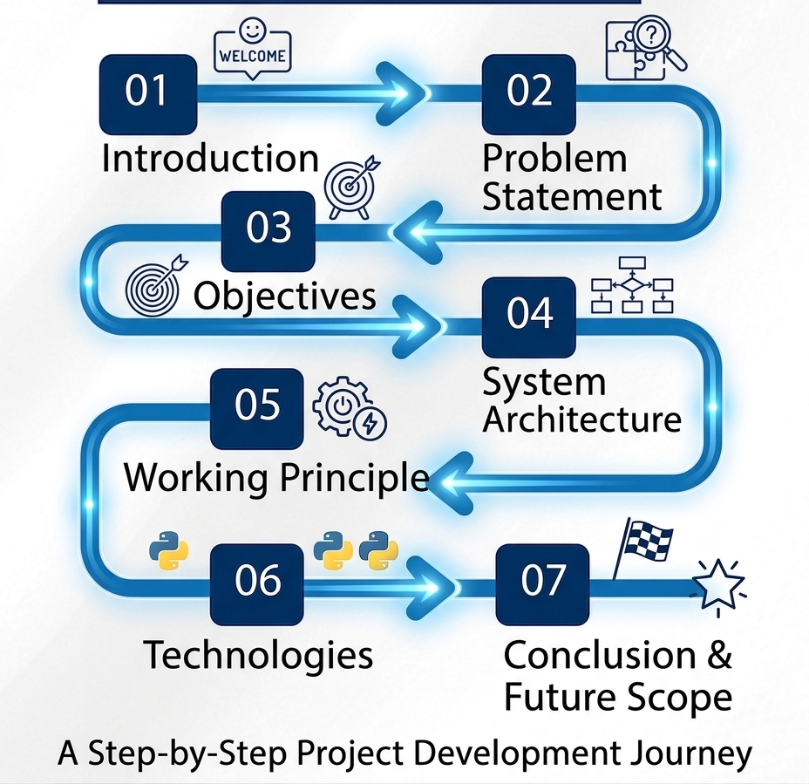







CONTENT
Introduction
Problem Statement
01
02
03
⁰⁴ System Architecture 05 Working Principle 06 Technologies Used
₀₇ Conclusion & Future Scope
Objectives

Slide 3

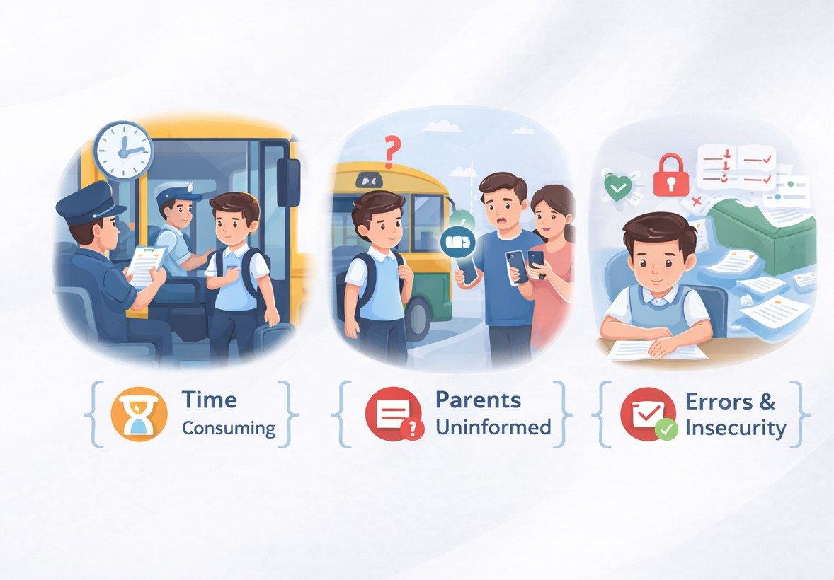

PROBLEM STATEMENT :
Manual attendance in school buses is time-consuming and prone to human errors.
There is no real-time system to inform parents when students board the bus.
Maintaining and verifying attendance records manually is inefficient and insecure.
A smart, automated solution is needed to ensure accuracy, safety, and instant communication.

Slide 4

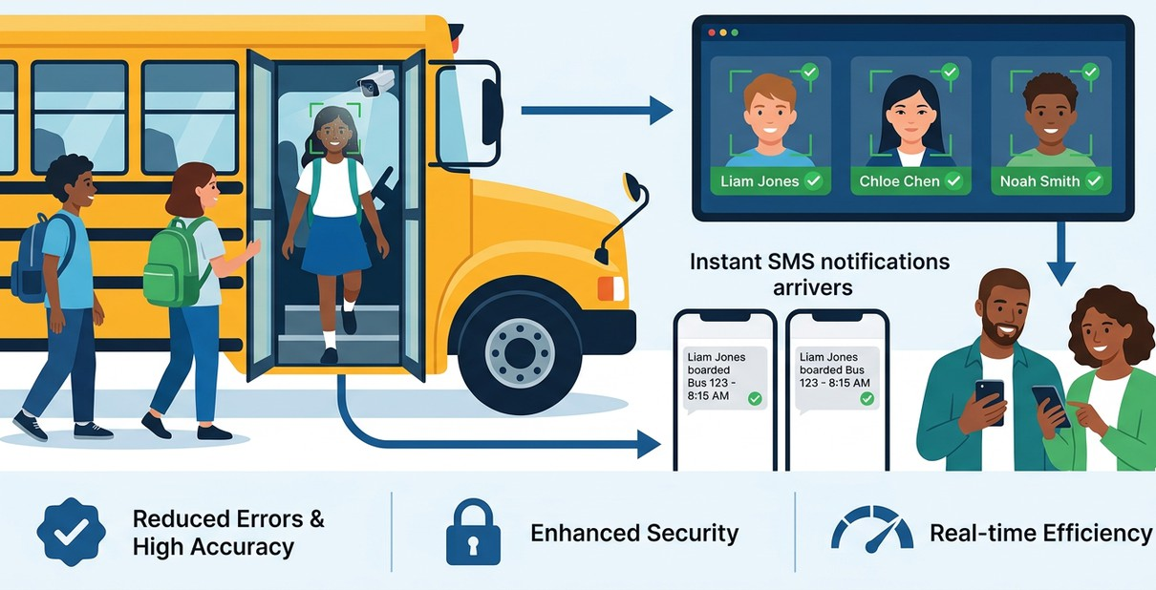
OBJECTIVES :
To design and implement an automated bus attendance system using Face Recognition technology.
To accurately identify students and record attendance in real time when they board the bus. To send instant SMS notifications to parents for improved safety and transparency.
To reduce manual errors and enhance efficiency, security, and reliability in student transport management.

Slide 5
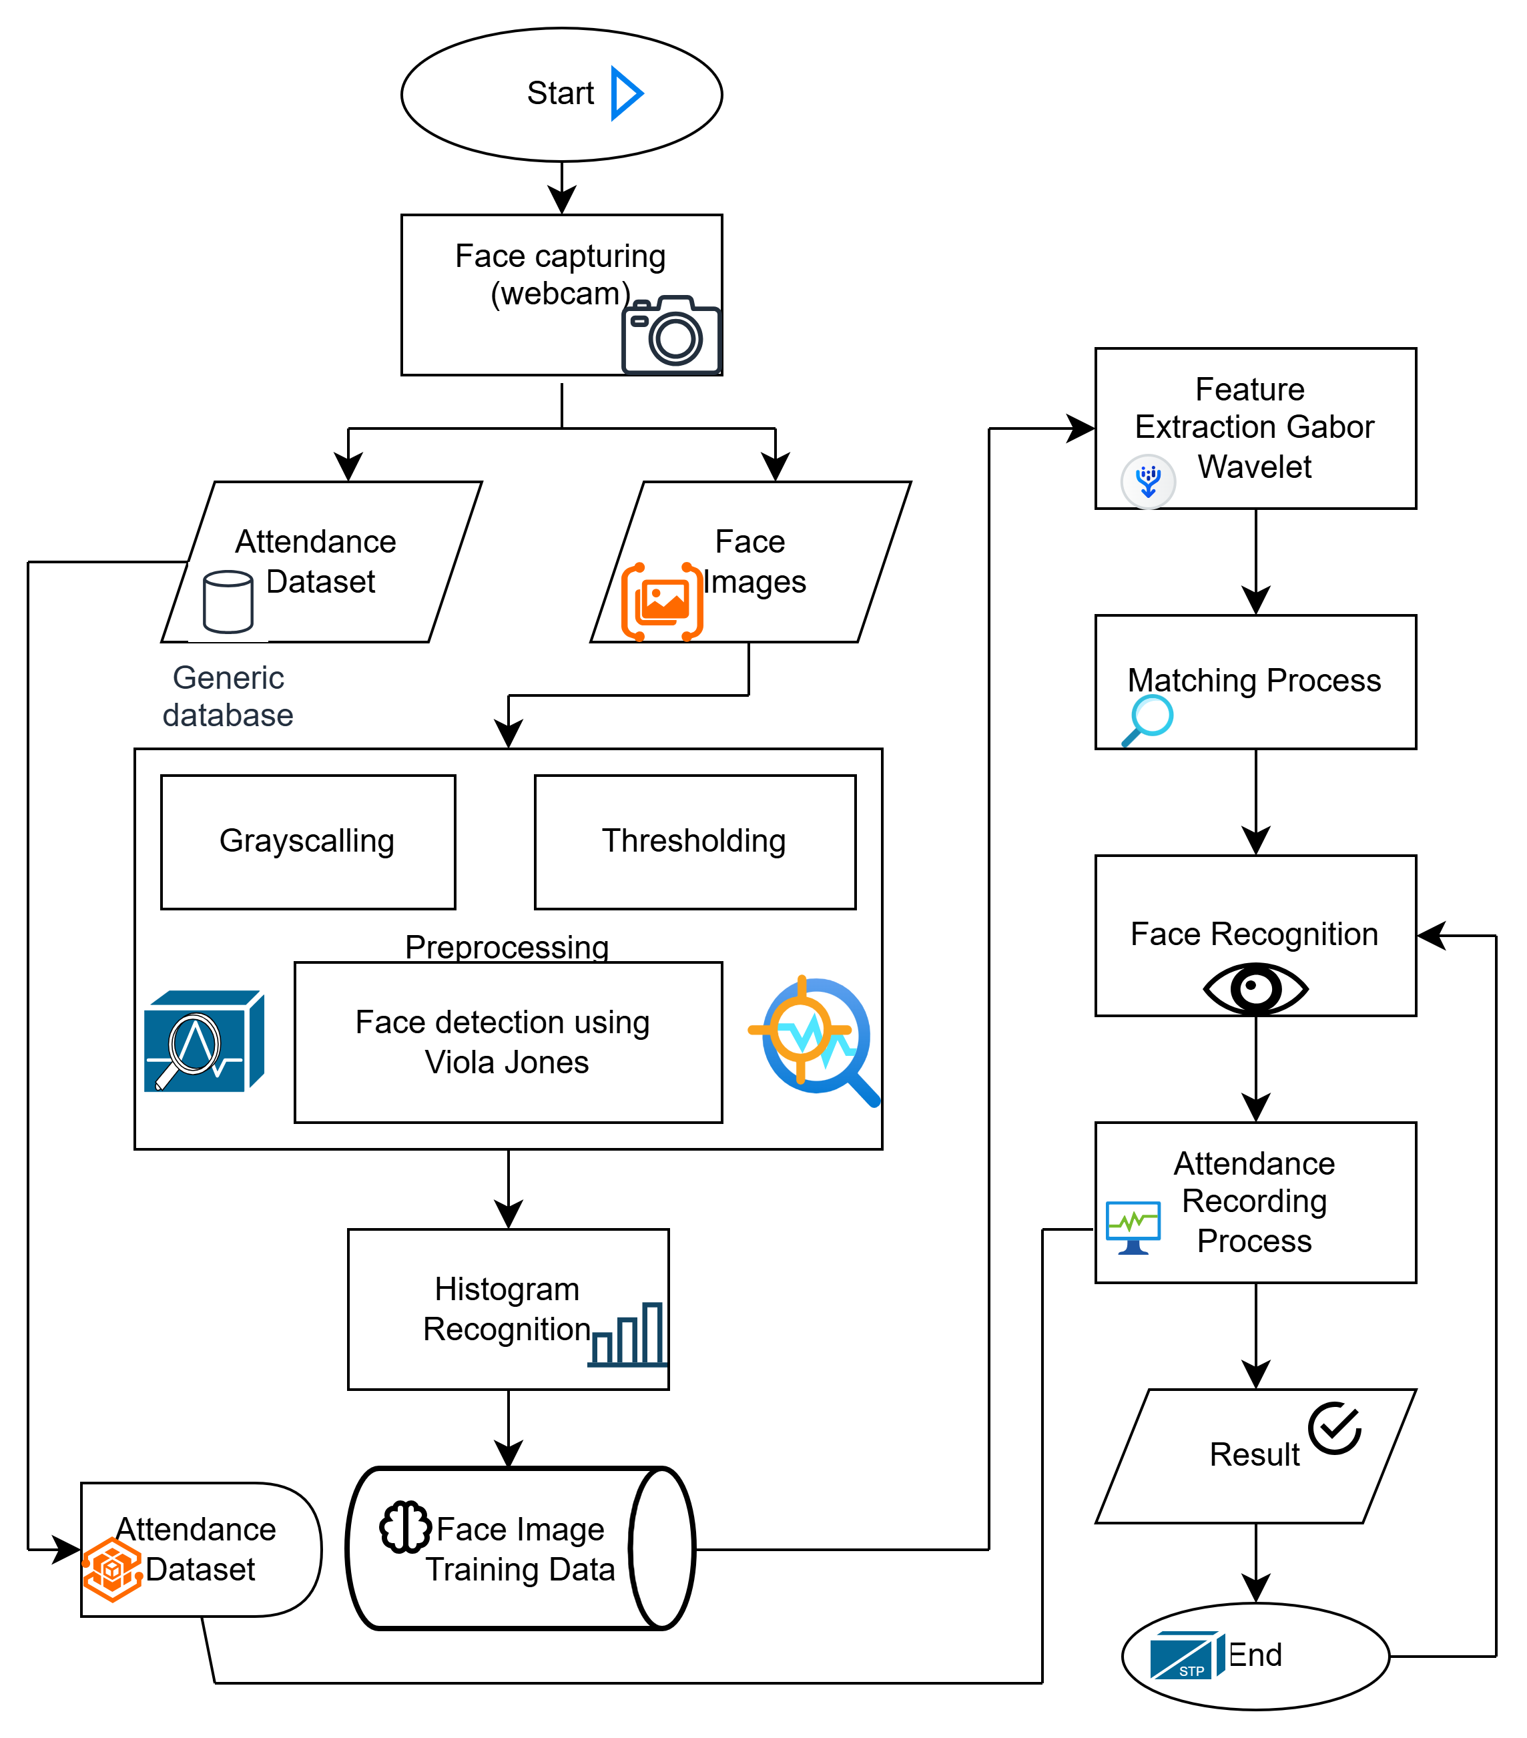
SYSTEM ARCHITECTURE:

Slide 6
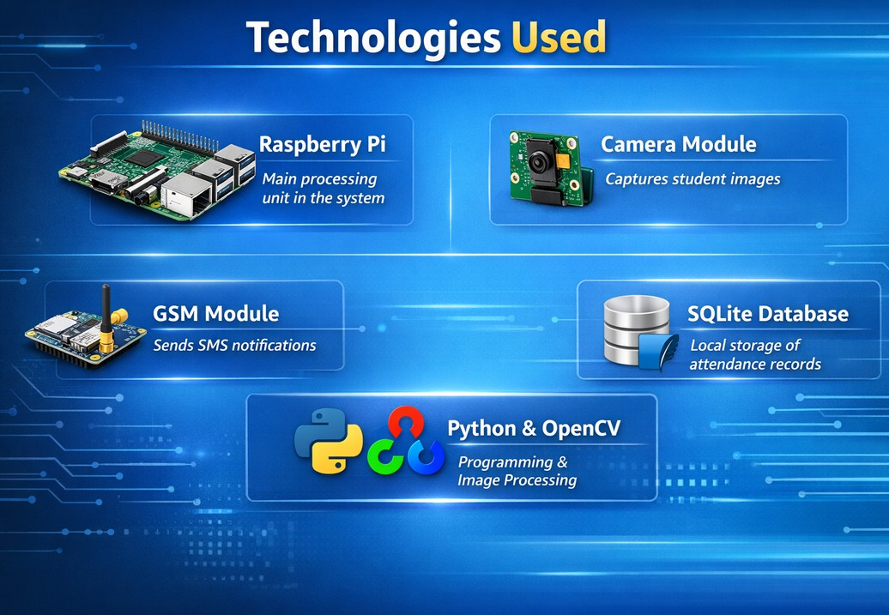
TECHNOLOGIES USED :
🔹 Raspberry Pi
Used as the main processing unit inside the bus to run the system.
🔹 Camera Module
Captures real-time images of students for face recognition.
🔹 GSM Module
Sends SMS notifications to parents after attendance is marked.
🔹 Python & OpenCV
Python is used for programming, and OpenCV is used for face detection and image processing.
🔹 SQLite Database
Stores student details and attendance records locally in the system.

Slide 7
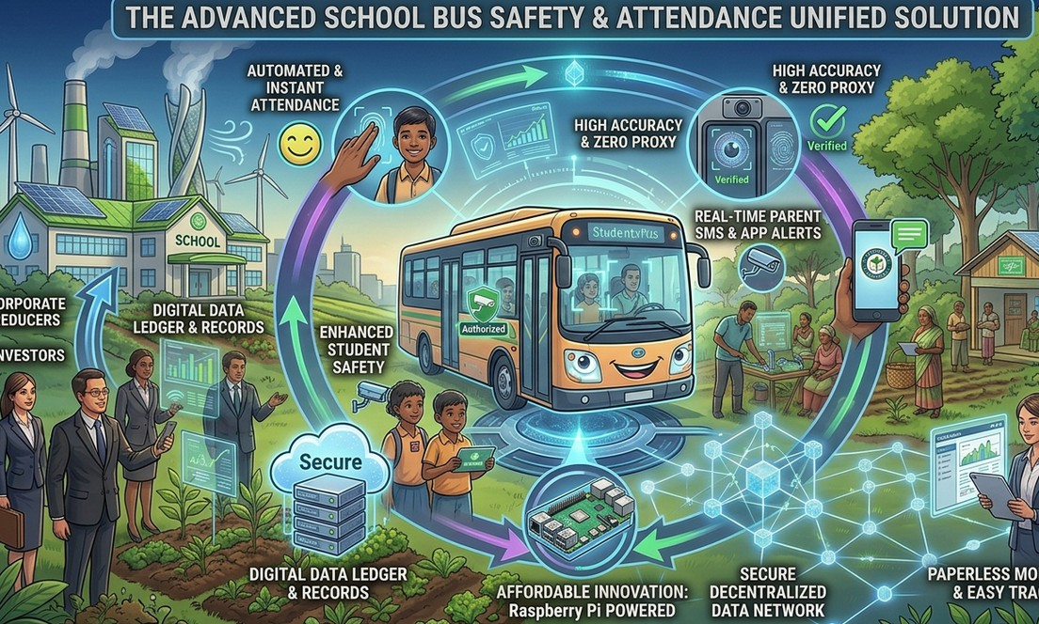
ADVANTAGES :
Automated Attendance – No manual marking
High Accuracy – Reduces human errors
Time Efficient – Instant attendance recording
Student Safety – Only authorized students allowed
SMS Alerts – Parents get real-time notifications
Secure Storage – Digital attendance records
Less Paperwork – No manual registers
Easy Monitoring – Simple tracking for schools
Cost Effective – Uses Raspberry Pi hardwar

Slide 8

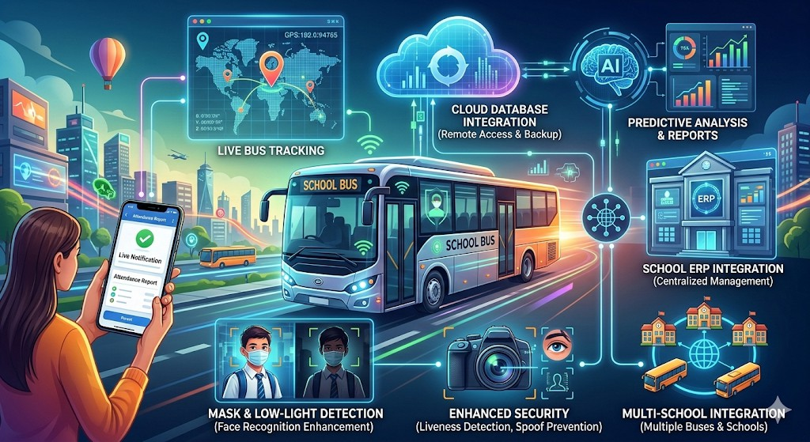

FUTURE SCOPE :
GPS integration for live bus tracking Mobile app for parents
Cloud-based data storage
AI-based attendance analytics Multi-school and multi-bus support Improved recognition accuracy Integration with school ERP system
85%

Slide 9
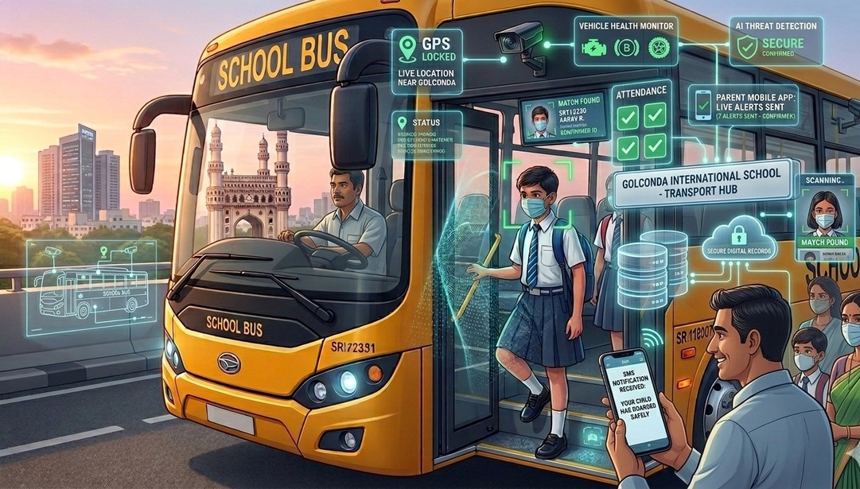

CONCLUSION :
Developed an automated bus attendance system using face recognition.
Eliminates manual attendance and reduces human errors.
Ensures real-time identification and attendance marking.
Sends SMS alerts to parents for improved student safety.
Provides secure and digital record management. Enhances efficiency and transparency in school transportation

Slide 10



THANK YOU

